Slide 1
GLOBAL FOOD RESOURCES
WHAT DO PEOPLE EAT AROUND THE WORLD AND HOW DO THEY GET THEIR FOOD?

Slide 2
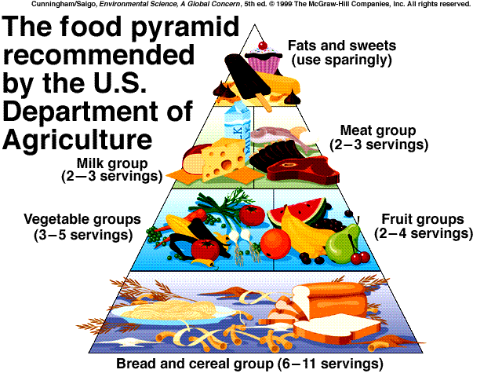

Slide 3
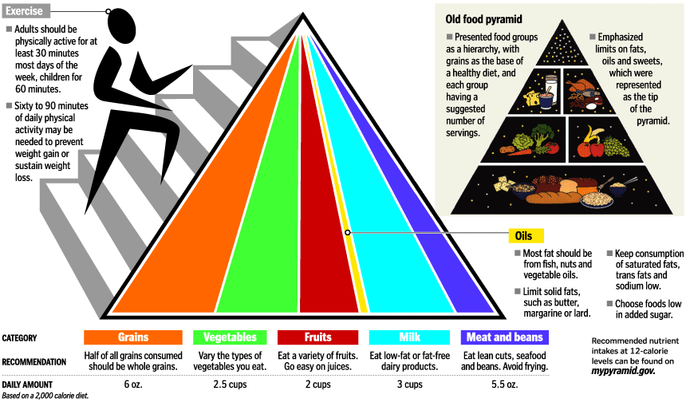

Slide 4
USA
Sources of Protein – fish, meat, poultry, beans, nuts, eggs.
Sources of Fiber – cereal, bread, rice, pasta
Fruits and Vegetables – plentiful
Dairy – plentiful, milk, cheese, yogurt
Fats and Oils – plentiful and overused leading to overnutrition.
Vitamins – plentiful and easily accessable

Slide 5
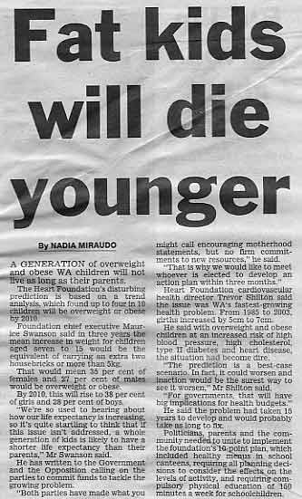
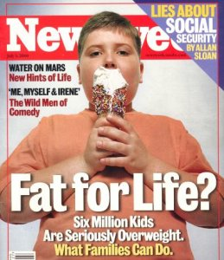
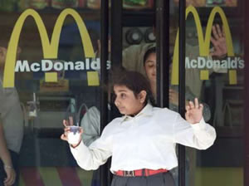
Recent Studies
Indicate that over 50% of all children will be overweight or suffer from over-nutrition by the year 2010!

Slide 6
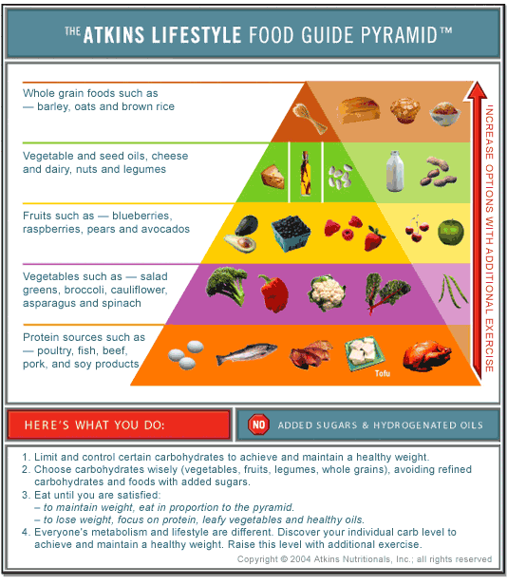
UNHEALTHY DIETS – Atkins/South Beach

Slide 7
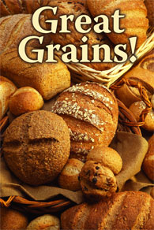
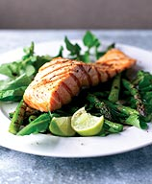
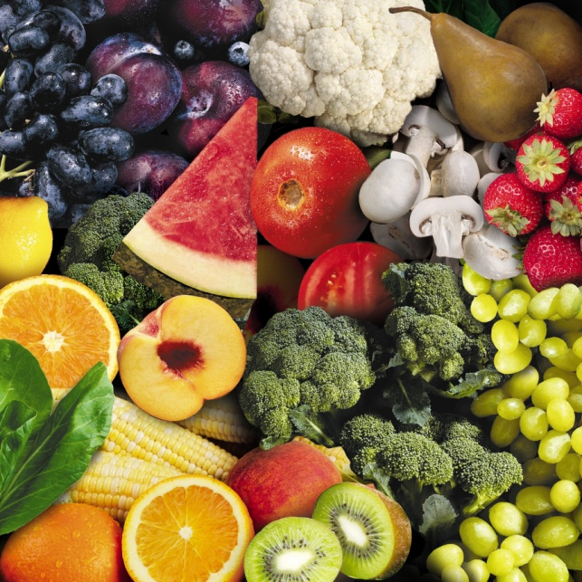
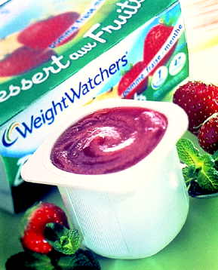

HEALTHY DIETS
Include eating reduced slightly reduced portions of carbohydrates, increased exercise, increased water intake, and decreased stress levels.

Slide 8
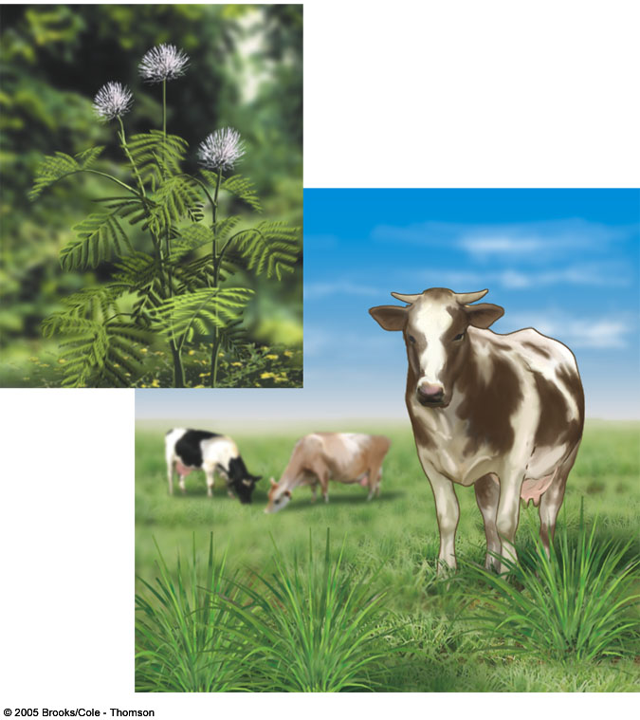
Food and Agriculture

Slide 9
History and Types of Agriculture
Demand-based agriculture - production determined by economic demand and limited by classical economic supply and demand theory. This approach became common during the industrial revolution.
Resource-based agriculture - production determined by resource availability; economic demand usually exceeds production. This approach was the original type of farming 10,000 years ago. Modern approaches are very high tech and somewhat more expensive.

Slide 10
Plant Food Sources
250,000 plant species ⇒
3000 tried as crops ⇒
300 grown for food ⇒
100 species used on large scale for food ⇒
15 to 20 species provide vast majority (90%) of man’s food needs
It takes about 16 pounds of grain to produce one pound of edible meat
Largest crop volumes provided by: wheat, rice, corn, potatoes, barley
  Wheat and rice supply ~60% of human caloric intake

Slide 11
Other Plant Food Sources
Potatoes
Barley
Sweet Potato
Cassava (source of tapioca)
Grape
Soybean
Oats
Sorghum
Sugarcane
Millet
Banana
Tomato
Sugar Beet
Rye
Orange
Coconut
Cottonseed
Apple
Yam
Peanut
Watermelon
Cabbage
Onion
Bean
Pea
Sunflower Seed
Mango

Slide 12
Green Revolution (1950-1970)
Plant monocultures to obtain high yields.
Input pesticides and fertilizers to obtain high yields.
Increase frequency and intensity of cropping to obtain high yields.
Was all of this done to “feed the world” or make high profits?

Slide 13
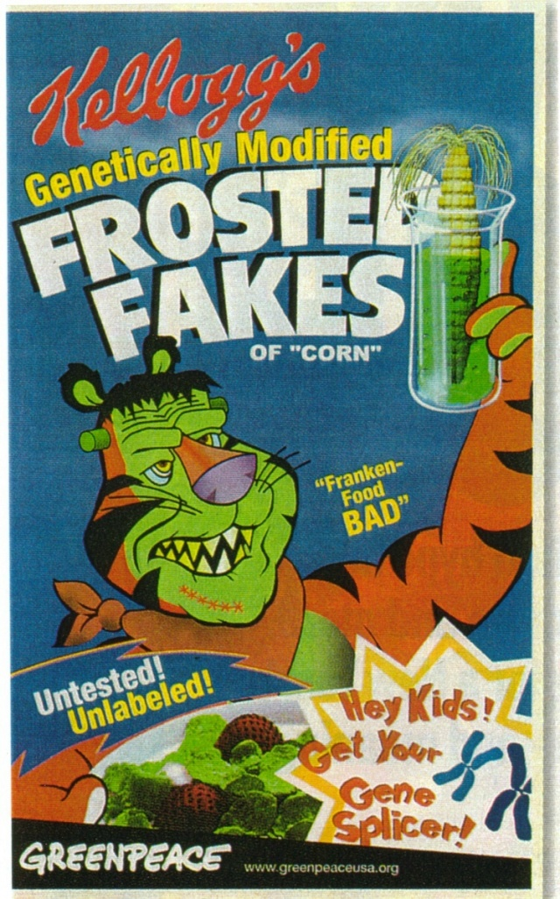
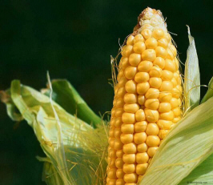
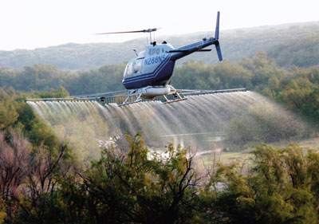
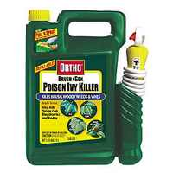
2nd Green Revolution
Introduction of genetically modified crops to obtain high yields
New herbicides introduced

Slide 14
New Green Revolution
Goal: Obtain high yields in an environmentally friendly way by introducing
Integrated Management Plans (IPM’s)
Terracing
Intercropping

Slide 15
Types of Crops
Cash Crops
  cash crops are grown for profit
  (U.S.) primarily corn, wheat, soybeans
  may provide non-food products (latex) or provide products which do not make up our primary nutrition (tea, coffee)
Subsistence Crops
  Crops used to feed the producer’s own family or to feed the producer’s livestock
  Primarily wheat and barley

Slide 16
Agroecosystems
Ecosystem created by agricultural practices
  characterized by low
    Genetic diversity
    Species diversity
    Habitat diversity

Slide 17
Agroecosystems
Agroecosystems differ from natural ecosystems in five major ways:
Farming attempts to stop ecological succession
Species diversity is low
  farmers usually practice monoculture
  monoculture tends to ⇓ soil fertility
Farmers plant species (crops) in an orderly fashion - this can make pest control more difficult
Food chains are far more simple in agroecosystems
Plowing is like no other natural disturbance
  plowing can ⇑ erosion
  cause more nutrient loss (which is replaced by fertilizer)

Slide 18
World Food Supply and the Environment
Our current food problem is the result of our human population
Food production depends upon favorable environmental conditions
Agriculture changes the environment - such changes can be detrimental
Food supply can be adversely affected by social unrest that influence agriculture

Slide 19
Grain Production
Grain production increased from 631 to 1780 million metric tons from 1950 to 1990.
Has leveled off since then
Top five countries in order of producing the most amount of grain are:
  China
  United States
  India
  Canada
  Ukraine

Slide 20
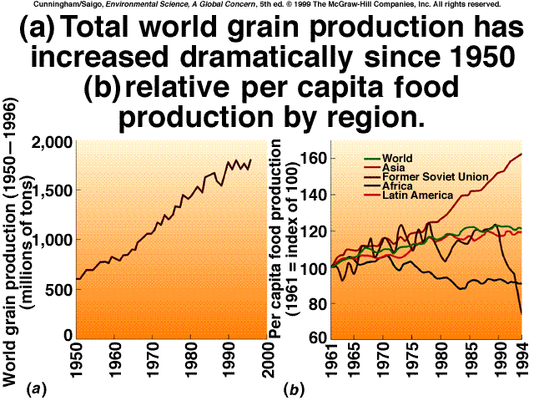

Slide 21
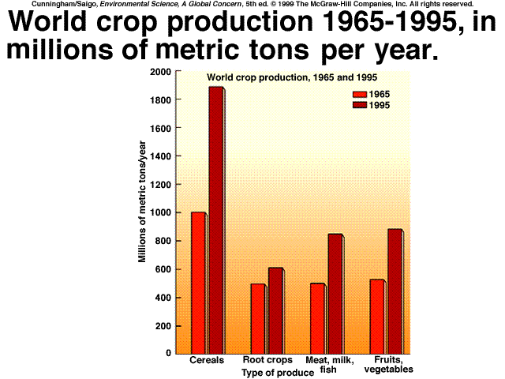

Slide 22
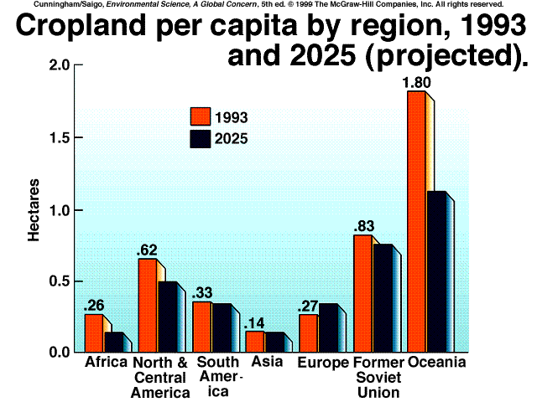

Slide 23
Livestock
• domesticated livestock (sheep, pigs, chickens, cattle) are an important food source for humans
• ruminants (four-chambered stomachs) contain bacteria that can convert plant tissue to animal protein/fat ⇒ hence, plant material originally unusable for man is converted into food sources that can be ingested by man

Slide 24
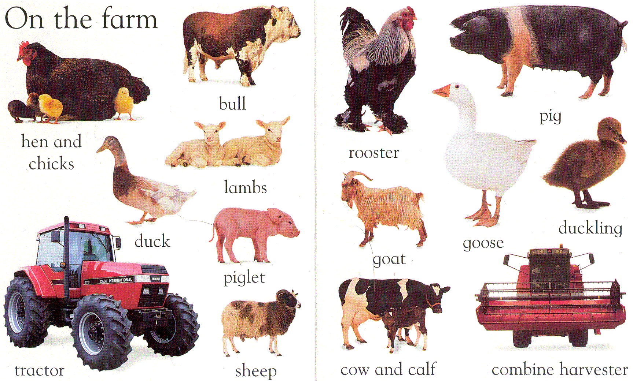
Wilkes, Angela. My first word board book. (1999) DK Publishing, NY.

Slide 25
Meat Sources
About 90% of all meat and milk are consumed by United States, Europe and Japan which constitute only 20% of world population
About 90% of the grain grown in the United States is used for animal feed
16 kg of grain ⇒ 1 kg of meat
  By eating grain instead would get 20 times the calories and 8 times the protein

Slide 26
Economics of a Hamburger
1 acre of forest supports 800,000 pounds of plants and animals.
1 acre = 43, 560 square feet
1 bovine = 200 pounds of actual beef
200 pounds of beef = (800) 4 ounce hamburgers
1 hamburger = ½ ton (1000 pounds) of forest products
1 hamburger = 55 square feet of forest
Two 4oz. Hamburgers will fill 45-50 bowls with cooked cereal grains for undernutrition/malnutritioned children in the USA.
2.1 million children under the age of 3 live in poverty in the USA!

Slide 27
Agricultural Methods
Polyvarietal Cultures – a plot is planted with several species of the same crop.
Example. Rice
Type A = normal strain
Type B = drought-resistant strain
Type C = nutrient-deficient strain
Multi-strains ensure that a crop will bring a profit under varying conditions, since annual weather is unpredictable.

Slide 28
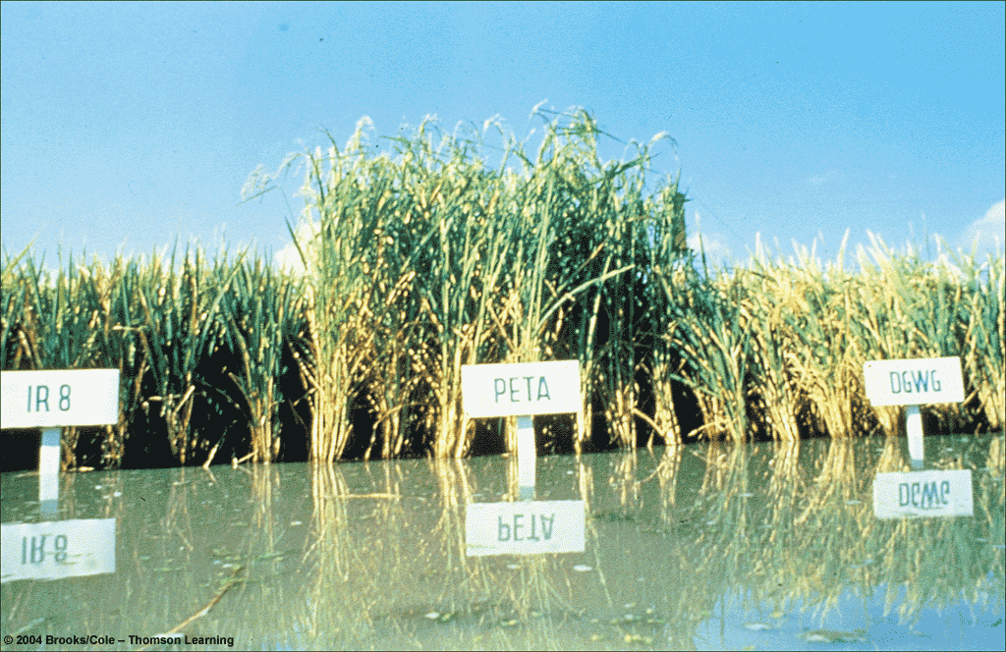
Polyvarietal Strains

Slide 29
Agricultural methods
Intercropping – two or more different crops are grown at the same time on a single plot.
Example, carbohydrate rich grains such as corn next to protein-rich legumes such as alfalfa that fixes nitrogen in the soils due to Rhizobium sp.

Slide 30
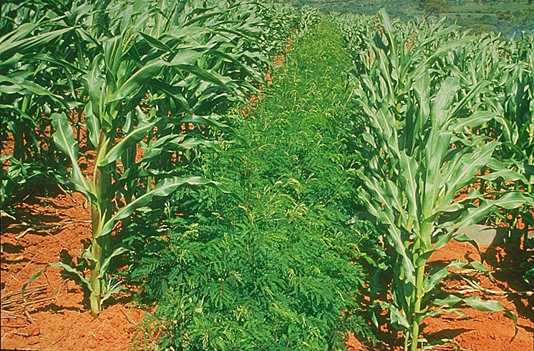
Intercropping

Slide 31
Agricultural Methods
Agroforestry – crops and trees planted together. This may include plantation trees. Trees provide shading to promote moisture-retention in soils.
Example, fruit-bearing trees planted with a grain and/or legume.

Slide 32
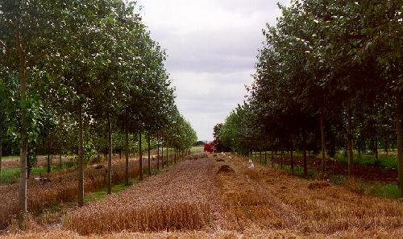
Agroforestry

Slide 33
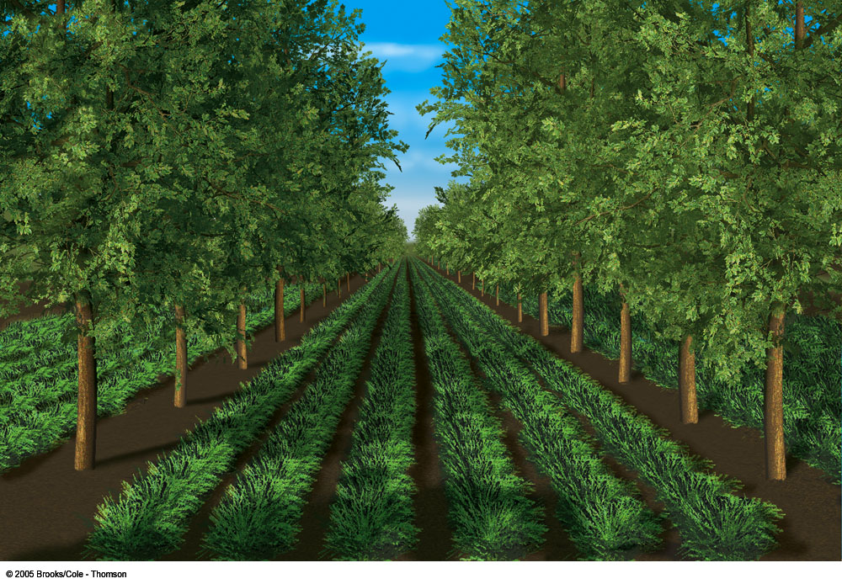
(c) Alley cropping

Slide 34
Agricultural Methods
4. Polyculture – a complex form of intercropping. Many different species/varieties of plants will mature at different times. This ensures year-round crop production and habitat for pests and wildlife.
  Produces high sustainable yields.
  Provides medicine, fuel, natural pesticides and natural fertilizers.
  Reduces environmental degradation from pesticides and irrigation and reduces crop losses overall.

Slide 35
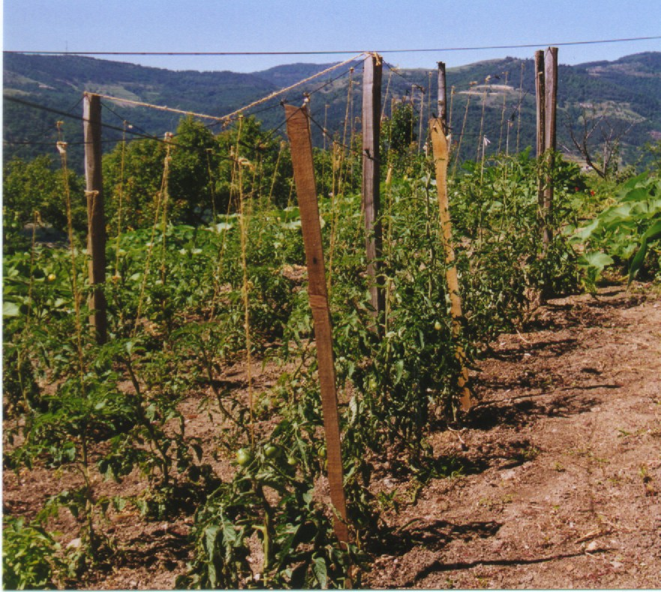
Polyculture

Slide 36
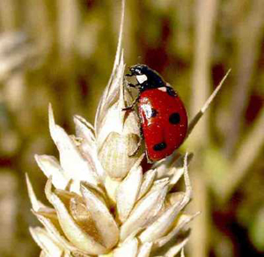
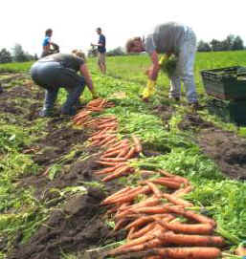
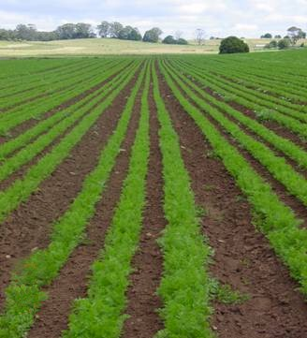
Agricultural Methods
Organic Farming – Does not apply inorganically manufactured fertilizers (or sludge-product), pesticides, genetically modified varieties, nor adds hormones or uses antibiotics (in meats and poultry).

Slide 37
Success of Organic Farming
Provides a healthier way of life (no bioaccummulation of chemicals)
Reduces environmental degradation
Allows for maintenance or increases to biodiversity by reducing nutrient and toxicity loading to environment
Allows for safe working conditions for farmers and employees

Slide 38
Failures of Organic Farming
Unfavorable climate reduces cash crop because there are no genetically modified varieties used (drives the consumer cost up)
Global warming and increased deforestation of rain forests are reducing precipitation in critical areas, thereby requiring increased irrigation use (drives consumer cost up)
No fertilizers/pesticides used so the crop is more susceptible to damage and disease (drives consumer cost up)
Basic Economics – if demand is low, prices are high!
Winds carry genetically modified seed and pesticides onto “organically farmed” lands (Monsanto).

Slide 39
1990 Organic Food Protection Act
Designed to develop uniform national standards for being “organic”. USDA states that any food:
  Genetically engineered/modified;
  Fertilized with municipal sludge;
  Zapped with radiation
…IS NOT ORGANIC!

Slide 40
Pros of Food Subsidies
Farmers stay in business during low production years
Food production is encouraged
Low interest loans provided for new farmers

Slide 41
Cons of Food Subsidies
1. More food = overproduction which decreases profits and depresses global prices
2. Surplus becomes food aid, which is believed by most scientists, economists and politicians to reduce the incentive for recipients of food aid to grow their own
3. Farm Bill1990, 1996, 2002 – provides subsidies to farmers for overproduction and/or crop losses due to weather conditions. ONLY govt. assistance that reimburses business for “Act of God”

Slide 42

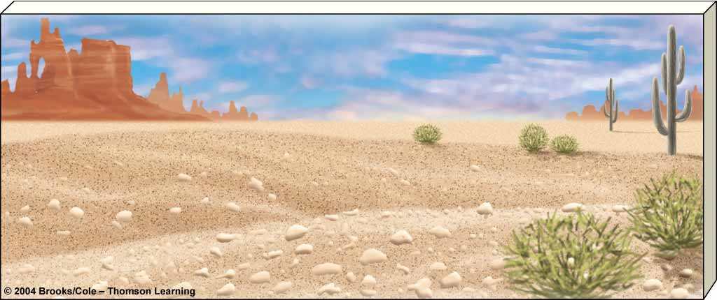

Environmental Degradation From Terrestrial Food Production
Causes
Consequences
Overgrazing
Deforestation
Erosion
Salinization
Soil compaction
Natural climate
change
Worsening drought
Famine
Economic losses
Lower living
standards
Environmental
refugees

Slide 43
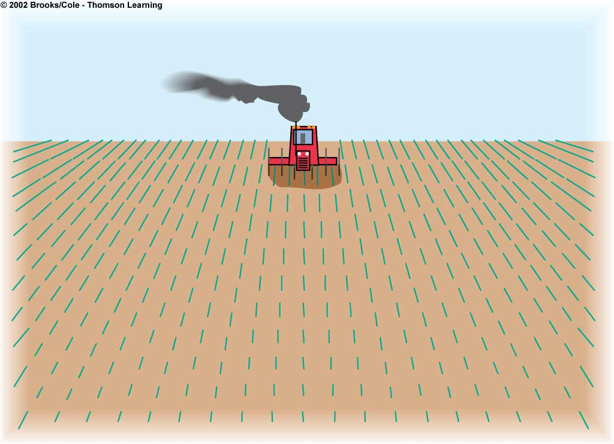
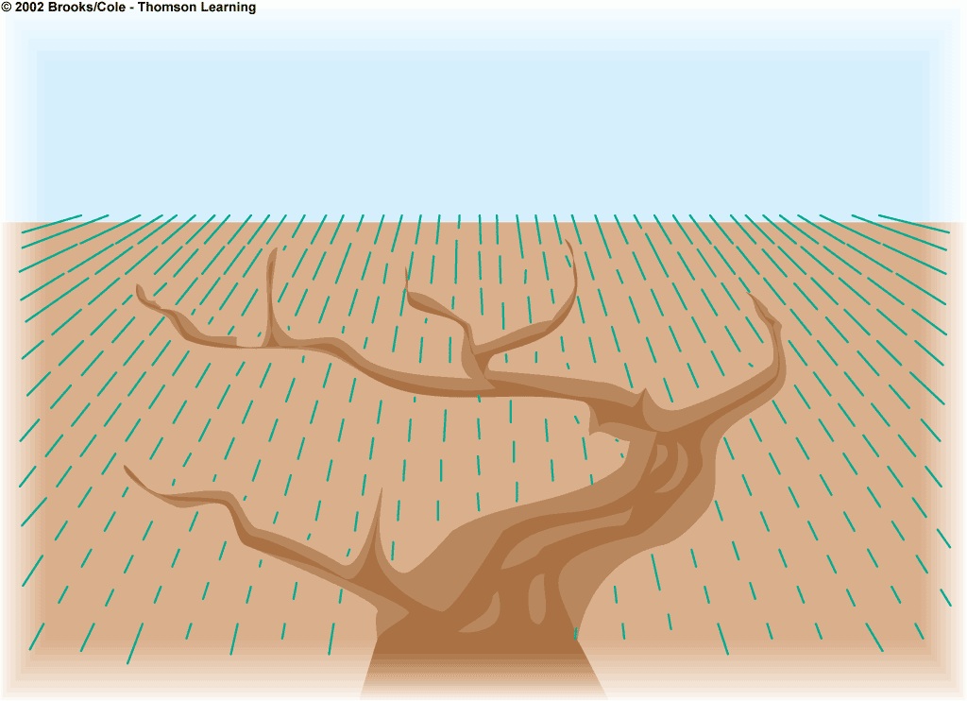
Biodiversity Loss
Soil
Loss and degradation of habitat from
clearing grasslands and forests and
draining wetland
Fish kills from pesticide runoff
Killing of wild predators to protect
livestock
Loss of genetic diversity from
replacing thousands of wild crop
strains with a few monoculture strains
Erosion
Loss of fertility
Salinization
Waterlogging
Desertification

Slide 44
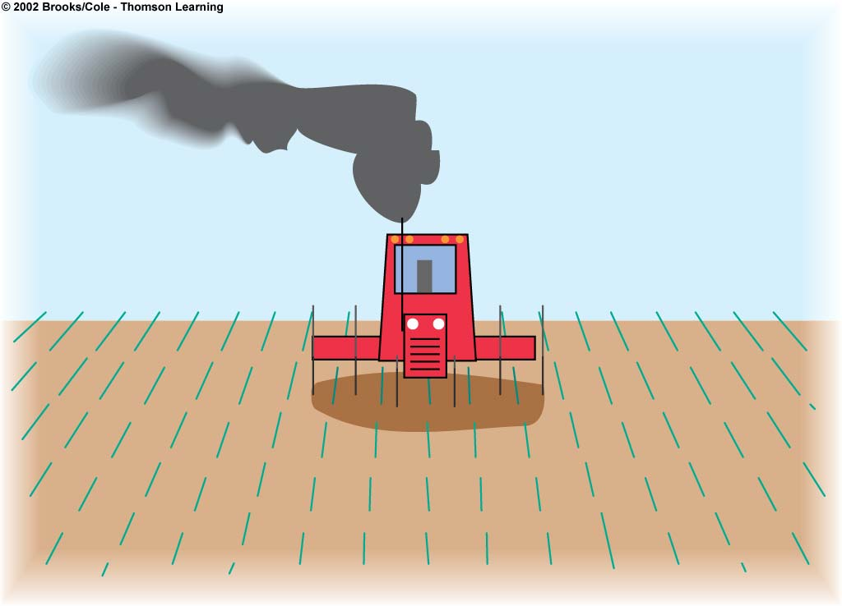
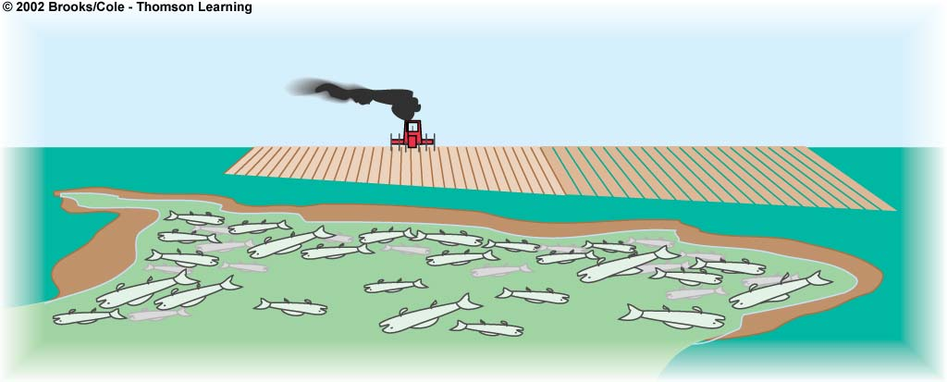
Air Pollution
Water
Greenhouse gas emissions from fossil
Fuel issue
Other air pollutants from fossil fuel use
Pollution from pesticide sprays
Water waste
Aquifer depletion
Increased runoff and
flooding from land cleared
to grow crops
Sediment pollution from
erosion
Fish kills from pesticide
runoff
Surface and groundwater
pollution from pesticides
and fertilizers
Overfertilization of lakes
and slow-moving rivers
from runoff of nitrates
and phosphates from
fertilizers, livestock
wastes, and food
processing wastes

Slide 45
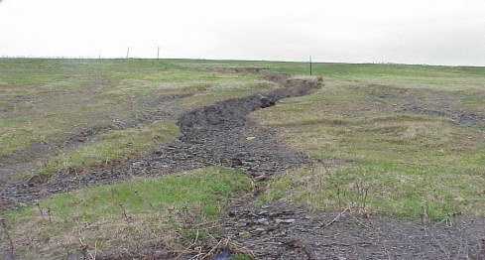
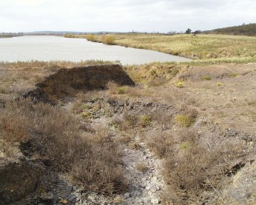
Sustainable Agricultural Methods
Terracing
Contour Farming
Strip Cropping
Agroforestry (Alley Cropping)
Windbreaks
Conservation Tillage Farming
Salt Flushing
Gully Reclamation

Slide 46
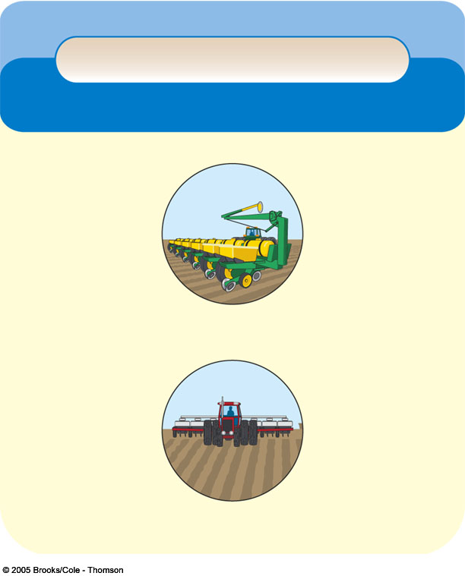
Figure 14-13
Page 284
Trade-Offs
Conservation Tillage
Advantages
Disadvantages
Reduces erosion
Saves fuel
Cuts costs
Holds more soil
water
Reduces soil
compaction
Allows several crops
per season
Does not reduce
crop yields
Reduces CO₂
release from soil
Can increase
herbicide use for
some crops
Leaves stalks that
can harbor crop
pests and fungal
diseases and
increase pesticide
use
Requires
investment
in expensive
equipment

Slide 47
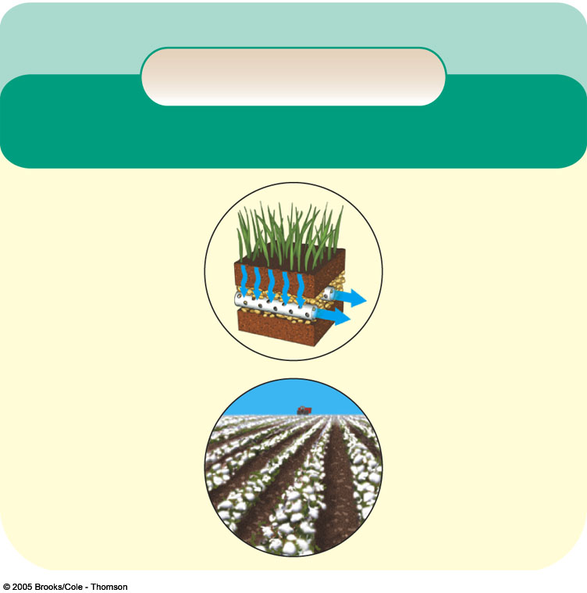
Figure 14-12
Page 283
Solutions
Soil Salinization
Prevention
Cleanup
Reduce irrigation
Switch to salt-
tolerant crops
(such as barley,
cotton, sugar beet)
Flushing soil
(expensive and
wastes water)
Not growing crops
for 2-5 years
Installing under-
ground drainage
systems (expensive)

Slide 48
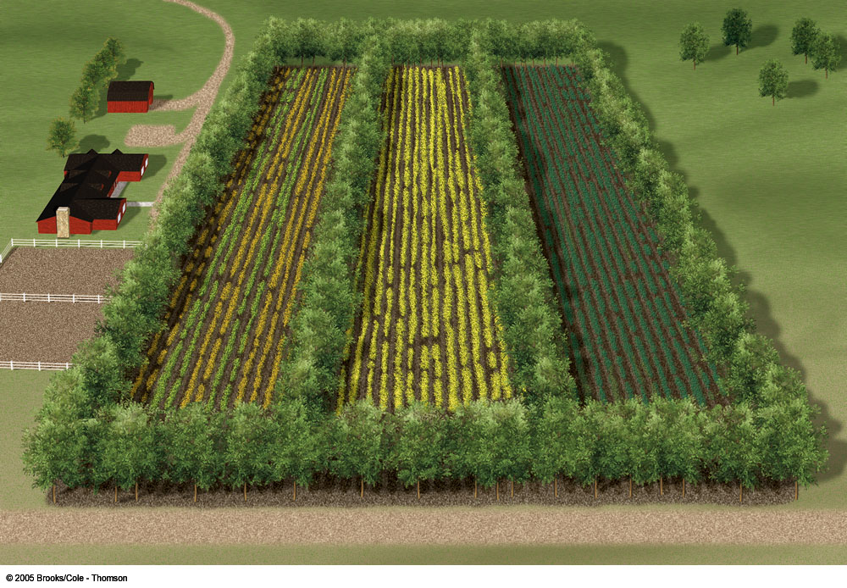
(d) Windbreaks

Slide 49
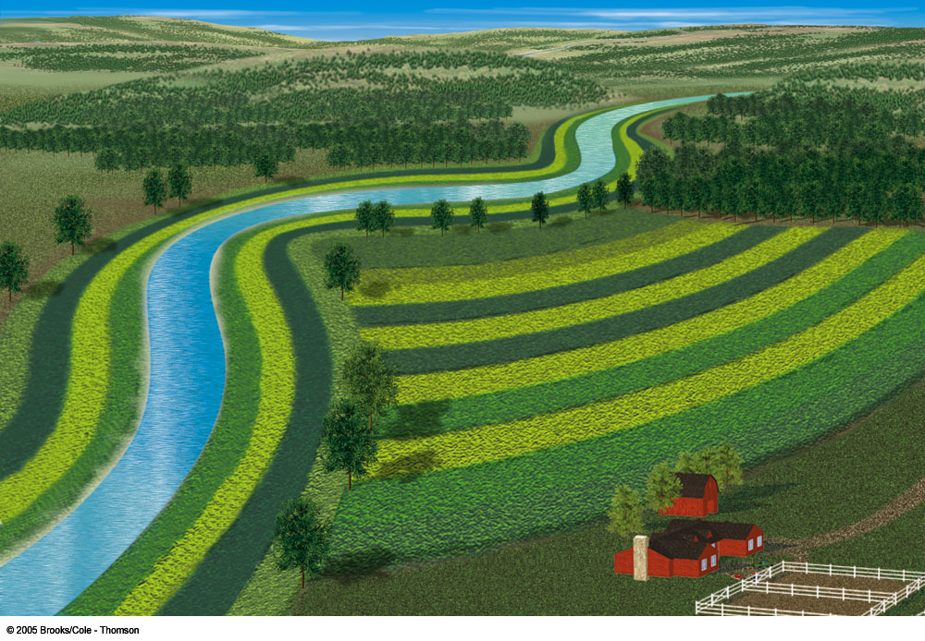
(b) Contour planting and strip cropping

Slide 50
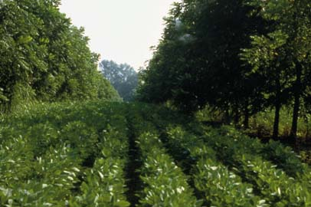
Alley Cropping

