Slide 1
Malnutrition

Slide 2
Unmet Nutritional Needs
Undernutrition – people who cannot grow or buy enough food to meet their basic energy needs.
Malnutrition – people who are forced to live on low-protein, high carbohydrate diet consisting of grains such as wheat, rice, and corn often suffer from malnutrition.
17% of the people in developing countries suffer from undernutrition and/or malnutrition.

Slide 3
Malnutrition and Famines
One quarter of the human population is malnourished
Sub-Saharan Africa (~225 million)
East and Southeast Asia (~275 million)
South Asia (~250 million)
Parts of Latin America

Slide 4
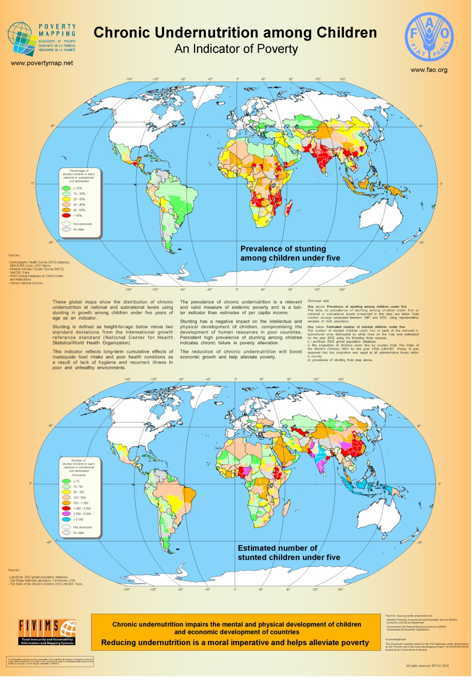

Slide 5
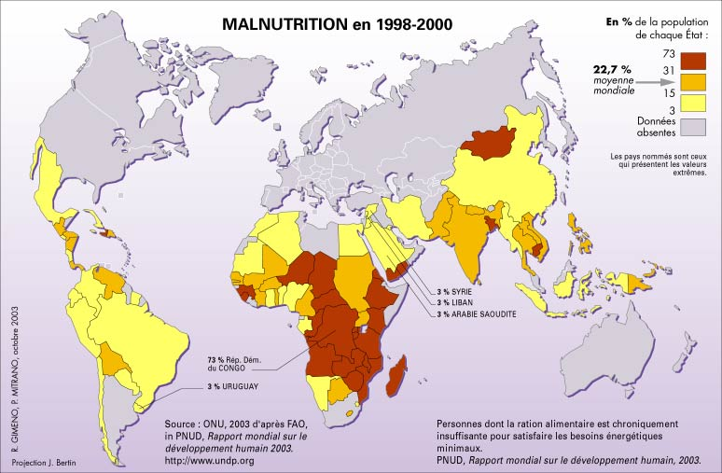

Slide 6
Malnutrition/Famines
Stem from not enough calories per day in addition to not getting the necessary amounts of carbohydrates, proteins, lipids (fats), minerals, and vitamins
Generally diets are high in starches
Famine conditions
Major droughts → Political instability
Population sizes → Land Seizures
Massive immigration → Pestilence
Floods → Distribution breakdown
Wars → Panic buying
Chaos in economy → Hoarding

Slide 7
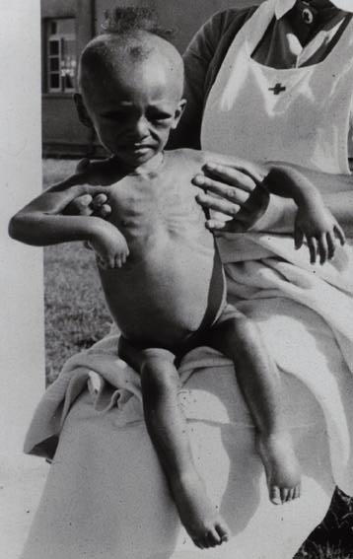
Kwashiorkor
Kwashiorkor – is a type of malnutrition that occurs in infants and very young children when they are weaned from mother’s milk to a starchy diet low in protein.

Slide 8
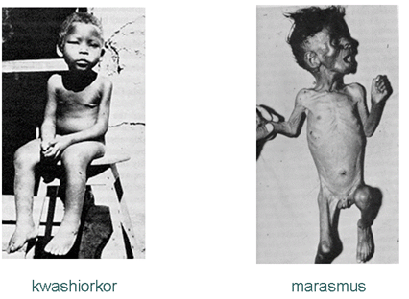
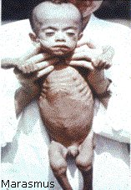
Marasmus
Marasmus – a nutritional deficiency disease caused by a diet that does not have enough calories and protein to maintain good health.

Slide 9
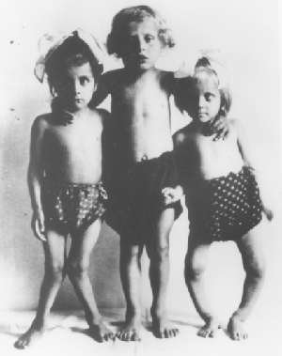
Rickets
Rickets is a deficiency of Vitamin D. This disease involves softening and weakening of bones in children due to deficiency of Vitamin D. This softening occurs from a loss of the mineral calcium from the skeleton as a result of which bones become flexible and gradually are molded by forces, such as bearing weight, that are exerted on them. This condition could lead to deformities of the body structure. Rickets is most likely to occur during periods of rapid growth, when the body demands high levels of calcium and phosphate. Rickets may be seen in young children 6 to 24 months old and is uncommon in newborns.

Slide 10
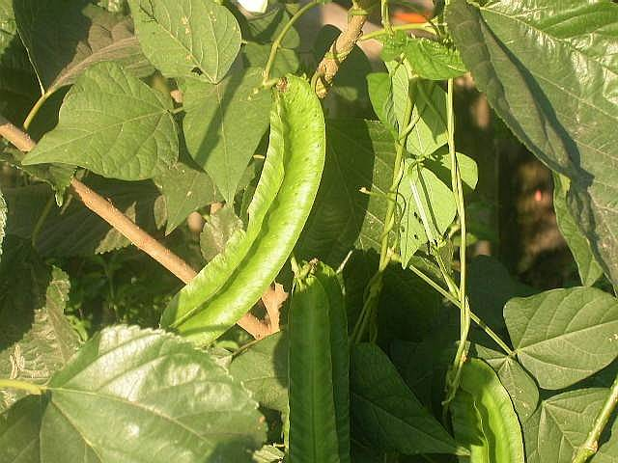
So How Do People Get Their Protein in Developing Nations?
BEANS
New Guinea – winged bean (legume)

Slide 11
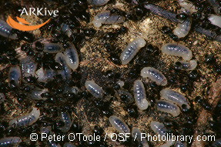
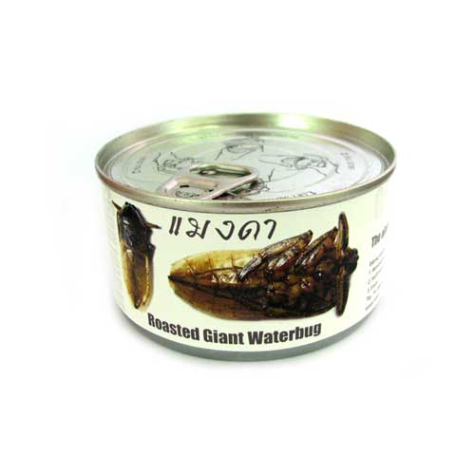
BUGS as PROTEIN
Mexico
Black ant larvae tacos
Thailand
Giant Waterbug Veggie Dip
Bugs provide higher protein value than beef, fish & eggs!

Slide 12
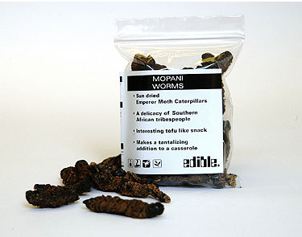
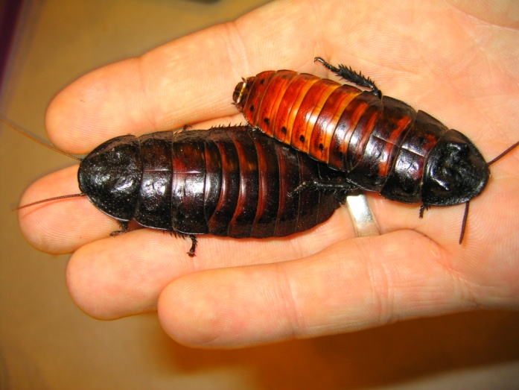
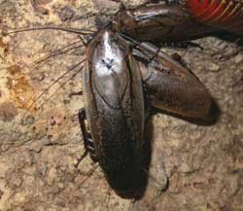
BUGS as PROTEIN
South Africa
Mopani (giant emperor caterpillar larvae
Kalahari
Cockroaches

Slide 13
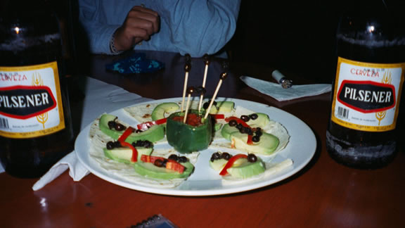
BUGS as PROTEIN
Bali
Lightly Toasted Butterflies
Columbia
French Fried Ants

Slide 14
USA
2.1 million children under the age of 5 live in poverty in the USA.
Poverty - The state of being poor; lack of the means of providing material needs or comforts.
WIC (Supplemental Nutrition Program for Woman, Infants, and Children) – provide assistance to support proper nutrition for general wellness and to help children focus and do well in school. Children who are hungry do not function at the same level in school as children who are well-fed.

Slide 15
Global Poverty & Famine
Famine - a drastic, wide-reaching food shortage.
Facts:
Half the world — nearly three billion people — live on less than two dollars a day .
“The lives of 1.7 million children will be needlessly lost this year [2000] because world governments have failed to reduce poverty levels”
“Approximately 790 million people in the developing world are still chronically undernourished, almost two-thirds of whom reside in Asia and the Pacific.”
According to UNICEF, 30,000 children die each day due to poverty. And they “die quietly in some of the poorest villages on earth, far removed from the scrutiny and the conscience of the world. Being meek and weak in life makes these dying multitudes even more invisible in death.” That is about 210,000 children each week, or just under 11 million children under five years of age, each year
“Today, across the world, 1.3 billion people live on less than one dollar a day; 3 billion live on under two dollars a day; 1.3 billion have no access to clean water; 3 billion have no access to sanitation; 2 billion have no access to electricity.”

Slide 16
Children of the World
Number of children in the world = 2.2 billion
Number in poverty = 1 billion (every second child)
For the 1.9 billion children from the developing world, there are:
640 million without adequate shelter (1 in 3)
400 million with no access to safe water (1 in 5)
270 million with no access to health services (1 in 7)
Children out of education worldwide = 121 million
Survival for children
Worldwide,
10.6 million died in 2003 before they reached the age of 5 (same as children population in France, Germany, Greece and Italy)
1.4 million die each year from lack of access to safe drinking water and adequate sanitation
Health of children
Worldwide,
2.2 million children die each year because they are not immunized
15 million children orphaned due to HIV/AIDS (similar to the total children population in Germany or United Kingdom)

Slide 17
Global Spending (US $ Billions)
Cosmetics in the United States -8
Ice cream in Europe - 11
Perfumes in Europe and the USA-12
Pet foods in Europe and USA – 17
Business entertainment in Japan -35
Cigarettes in Europe – 50
Alcoholic drinks in Europe – 105
Narcotics drugs in the world – 400
Military spending in the world -780

Slide 18
Global Priorities for Social Services (US $ Billions)
Basic education for all – 6
Water and sanitation for all – 9
Reproductive health for all women -12
Basic health and nutrition -13

Slide 19
Limits on Food Production
• arable land
• precipitation
• temperature
• global warming (ice age temp was only 5º C less than now!)

Slide 20
Methods to Increase Food Supply
Improved irrigation and utilization of water
Drip irrigation
Increasing arable land
Difficult because of precipitation and temperature
Eating lower on the food chain
Most rangeland is not arable and humans cannot utilize grass/hay as food; therefore, this argument is not considered valid

Slide 21
Methods to Increase Food Supply
Food distribution modification
Today distribution of food is a major problem in Africa/Asia
Best solution: teach locals how to best utilize their land with appropriate technology so they can attempt to support themselves and not rely on others.

Slide 22
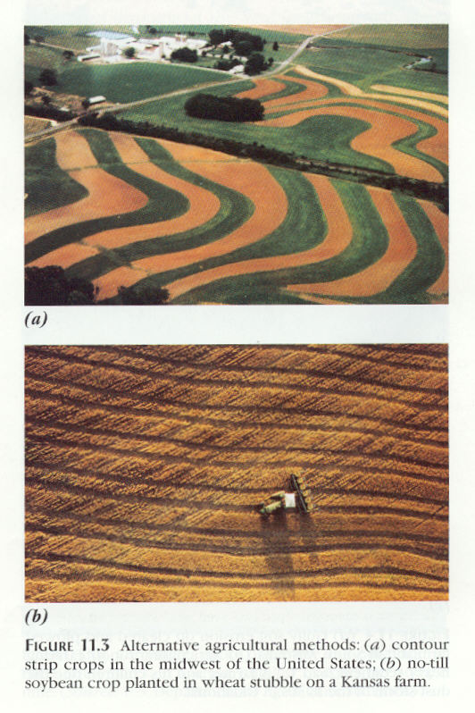

Slide 23
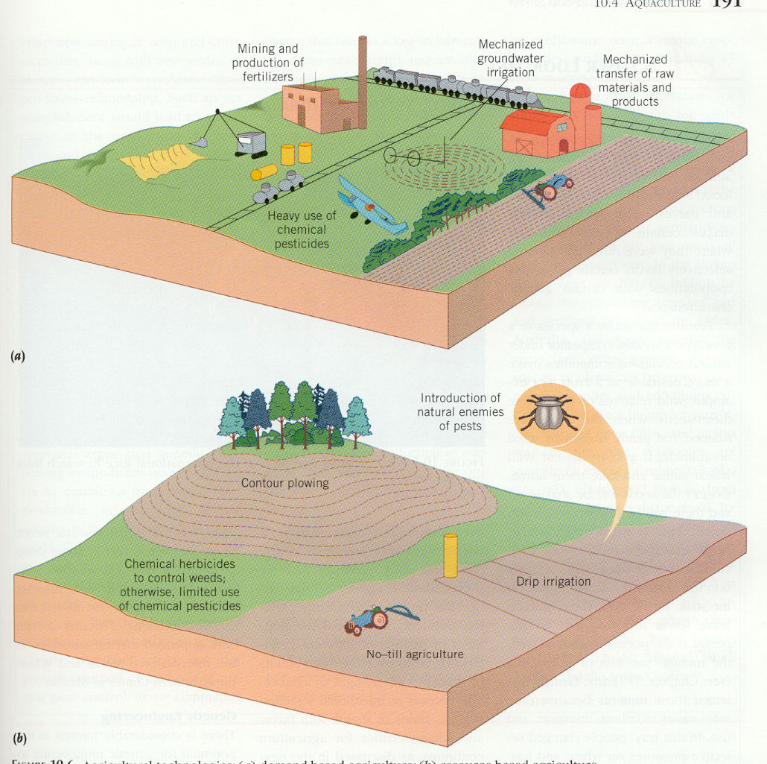
New vs. Old
Agriculture

Slide 24
“FEED THE CHILDREN”
Mission: Christian, International, non-profit, relief organization headquartered in Oklahoma City, OK.
Founder: Larry & Frances Jones – after reading article about surplus grains being dumped by American Farmers (Farm Bill) and seeing suffering children in Haitian children, formed this aid organization.
Domestic Programs: Food and Childcare and Disaster Relief.
International Programs: Food and Childcare, Medical Programs, and Community Development to improve quality of life!
Financial Summary: Where Does the Money Go?
Program Services (food, clothing, medical, relief, development, childcare and education) – 86.3%
Fund Raising – 11.0 %
Management & General Operating Costs including Salaries – 2.7%!

Slide 25
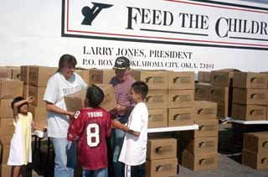
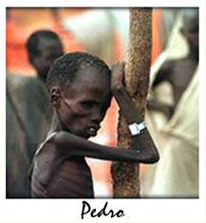
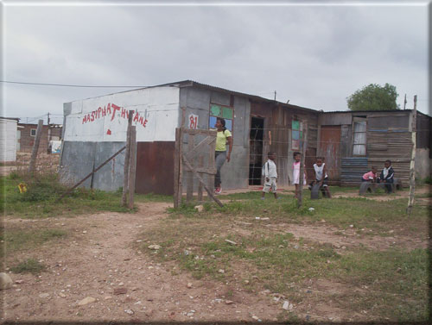

Slide 26
“Doctors Without Borders”
Doctors Without Borders/Médecins Sans Frontières (MSF) is an international independent medical humanitarian organization that delivers emergency aid to people affected by armed conflict, epidemics, natural or man-made disasters, or exclusion from health care in more than 70 countries.
MSF was founded in 1971 as a nongovernmental organization to both provide emergency medical assistance and bear witness publicly to the plight of the people it assists. A private, nonprofit association, MSF is an international network with sections in 19 countries.
Each year, MSF doctors, nurses, logisticians, water-and-sanitation experts, administrators, and other medical and non-medical professionals depart on more than 3,800 field assignments. They work alongside more than 22,500 locally hired staff to provide medical care.

Slide 27
“Doctors Without Borders”
In emergencies and their aftermath, MSF provides health care, rehabilitates and runs hospitals and clinics, performs surgery, battles epidemics, carries out vaccination campaigns, operates feeding centers for malnourished children, and offers mental health care. When needed, MSF also constructs wells and dispenses clean drinking water, and provides shelter materials like blankets and plastic sheeting.
Through longer-term programs, MSF treats patients with infectious diseases such as tuberculosis, sleeping sickness, and HIV/AIDS, and provides medical and psychological care to marginalized groups such as street children.

Slide 28
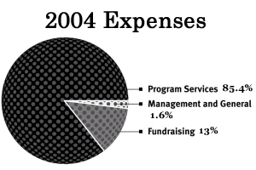
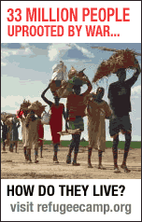
“Doctors Without Borders”

Slide 29
UNICEF
UNICEF (United Nation’s Children’s Fund) is a world-wide organization that fights for the protection of the health, rights, and education of children everywhere.
Services/Aids: 158 nations
Encourages females to attend school, vaccination clinics, protect environments, HIV/AIDS education
Financial Information: Total Revenue= $70 million
International Development – 54%
Education – 18%
Fundraising – 20%
Overhead and Expenses – 8%!

Slide 30
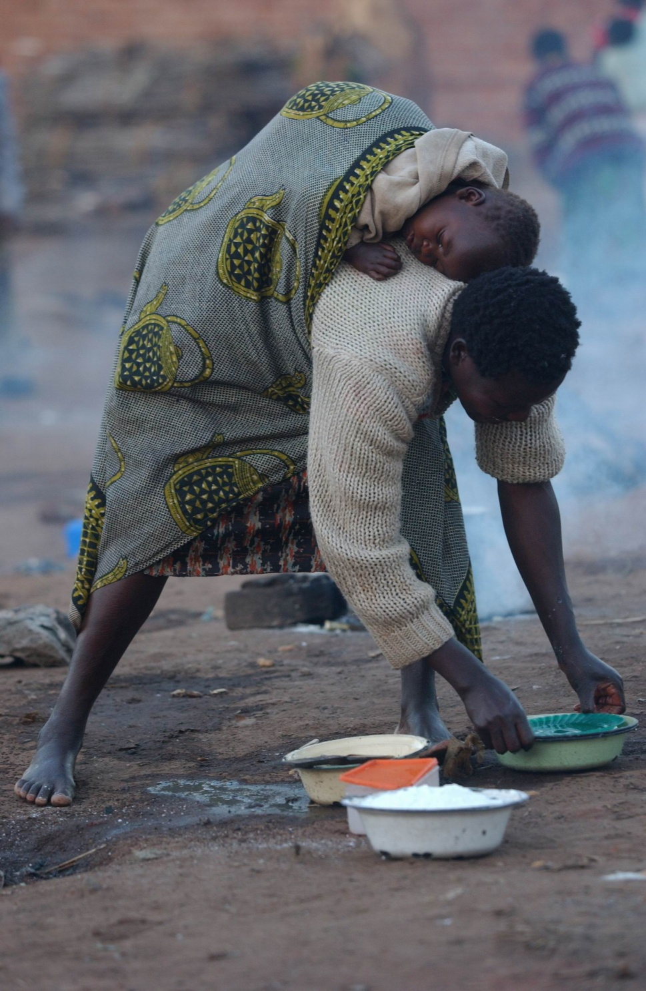
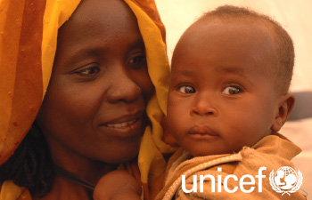

Slide 31
Heifer International
Heifer International was founded in 1944
Goals/Beliefs: ending hunger begins with giving people the means to feed themselves
Results: Today, millions of families in more than 127 countries have been given the gifts of self-reliance and hope. Every family and community receiving animals also receives training in environmentally-sound, sustainable agriculture. Recipient families "pass on the gift" by sharing one or more of their animals' offspring with other struggling families. Each recipient becomes a donor. This process enhances self-esteem, ensures program continuity, builds solidarity and multiplies the benefits of the original gift for generations to come.

Slide 32
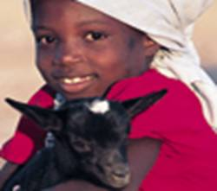
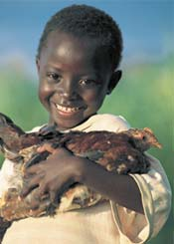
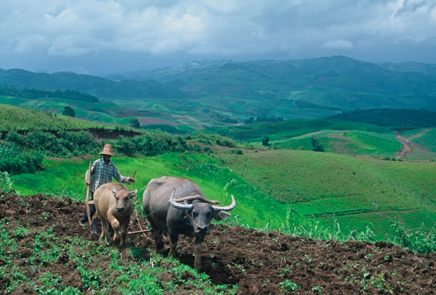
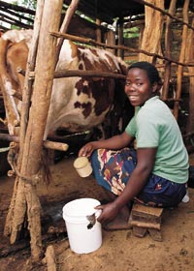

Slide 33
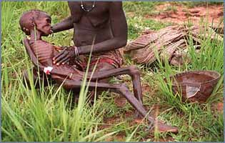
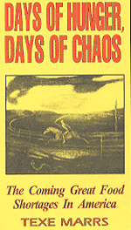
What Will Happen When Food/Water Demands Exceed Food/Water Supplies?
Famine
War
Depression
???

Slide 34
What Can You Do?
Support organizations that help teach countries how to become self-sustaining.
Conserve food resources.
Support food companies that practice sustainable food resource technology.
Become a volunteer.
Become a student abroad. (Heifer Study Tours www.heiferfoundation.org )

Slide 35
Arable Land

Slide 36
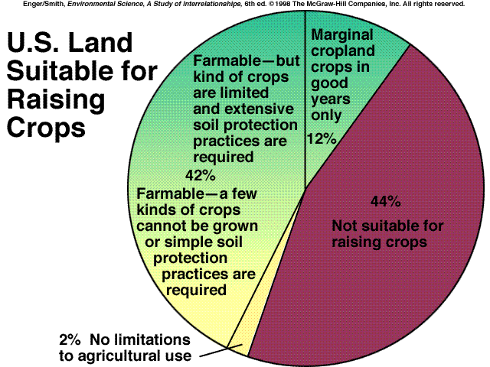

Slide 37
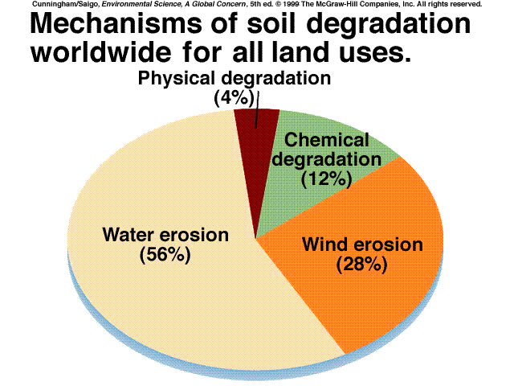

Slide 38
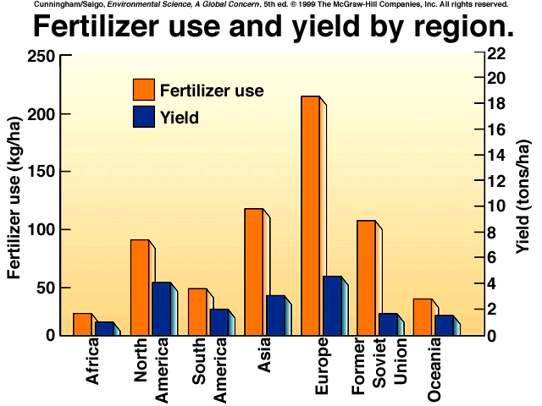

Slide 39
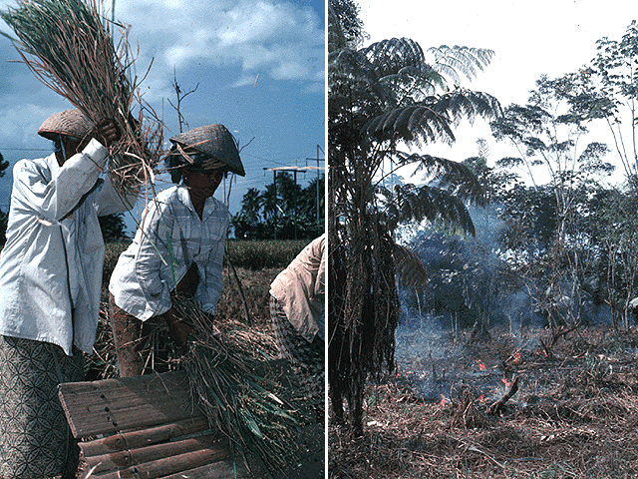

Slide 40
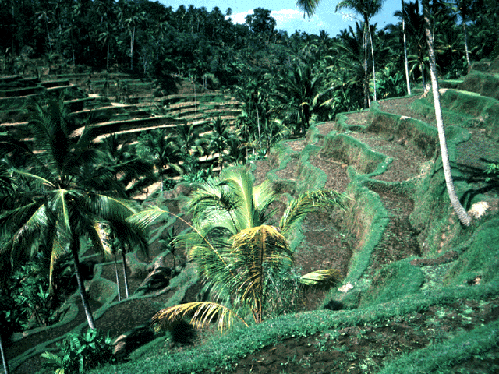

Slide 41
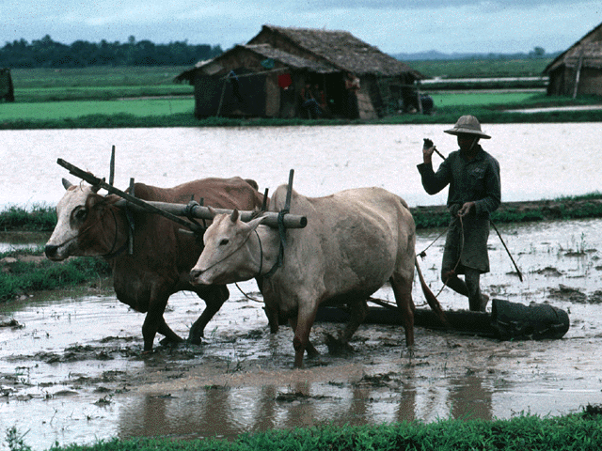

Slide 42
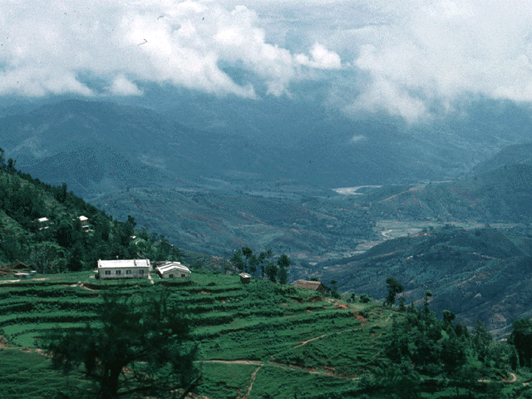

Slide 43
Pests and Pesticides

Slide 44
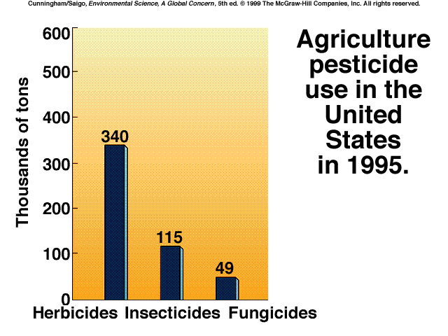

Slide 46
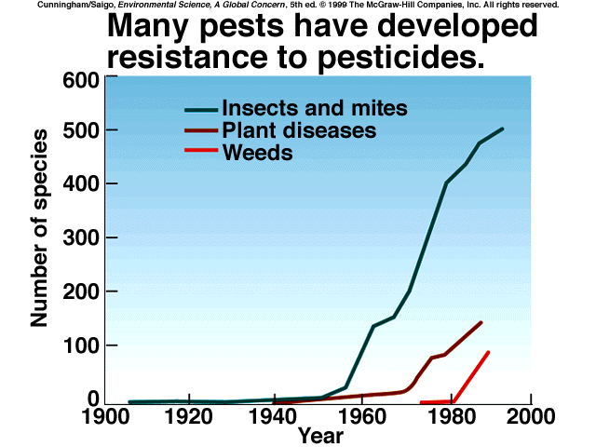

Slide 47
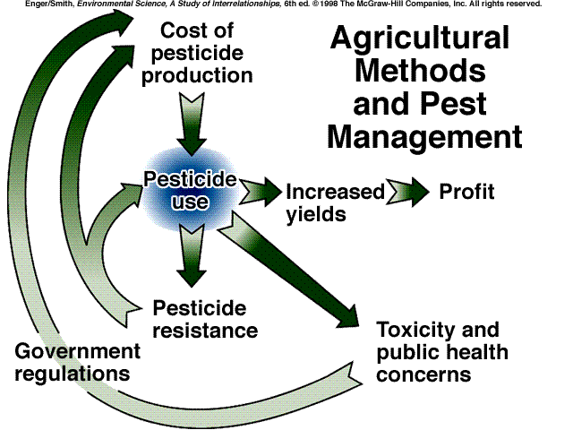

Slide 49
The problem with chemicals
Groundwater contamination
Effects of low concentrations?
Bioaccumulation and Biomagnification

Slide 50
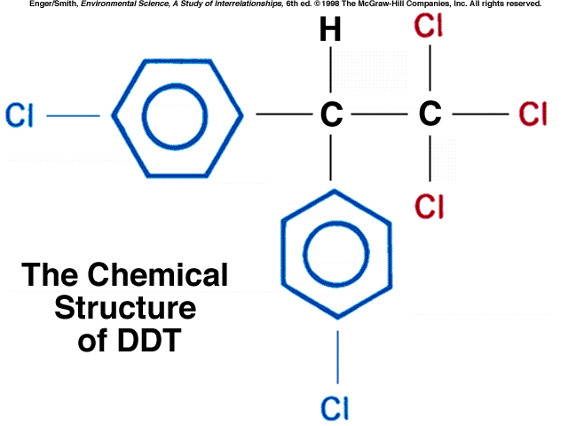

Slide 51
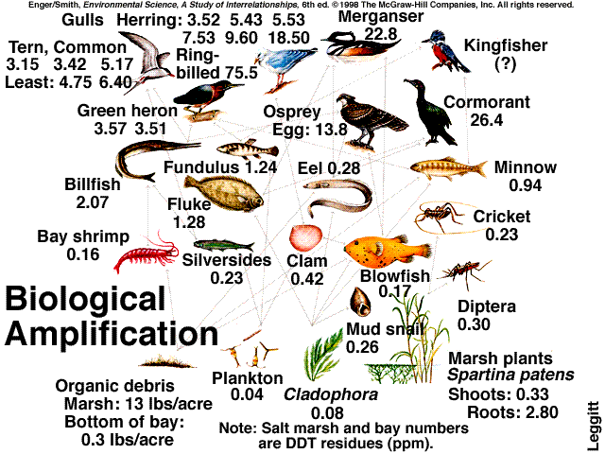

Slide 52
Pesticides Pros and Cons
Kill unwanted pests that carry disease (rats, mosquitoes, Tse-Tse flies)
Increase food supplies
More food means food is less expensive
Effective and fast-acting
Newer pesticides are safer, more specific
Reduces labor costs on farms
Food looks better
Agriculture is more profitable
Accumulate in food chain
Pests develop resistance – 500 species so far
Resistance creates pesticide treadmill
Estimates are $5-10 in damage done for $1 spent on pesticide
Pesticide runoff
Destroy bees - $200 million
Threaten endangered species
Affect egg shell of birds
5% actually reach pest
~20,000 human deaths/year

Slide 53
Types of Pesticides
Biological – Ladybugs, parasitic wasps, etc.
Carbamates – organic compounds that affect nervous system of pests; more water soluble than chlorinated hydrocarbons
Aldicarb, aminocarb, carbaryl (Sevin), carbofuran, Mirex
Chlorinated Hydrocarbons – affect nervous system; many are banned (like DDT and chlordane)
Aldrin, Chlordane, DDT, dieldrin, lindane and paradichlorobenzene
Fumigants – used to sterilize soil and prevent grain infestation

Slide 54
Types of Pesticides
Inorganic – arsenic, copper, lead, mercury
Highly toxic and susceptible to bioaccumulation
Organic or natural – derived from plants such as tobacco and chrysanthemum
Organophosphates – extremely toxic; low persistence
Malathion, parthion, chlophyrifos, acepate, propetamphos and trichlofon

Slide 55
Integrated Pest Management
Some practices for preventing pest damage may include:
inspecting crops and monitoring crops for damage
using mechanical trapping devices
natural predators (e.g., insects that eat other insects)
insect growth regulators
mating disruption substances (pheromones)
if necessary, chemical pesticides

Slide 56
Integrated Pest Management
Polyculture instead of monoculture
Intercropping – alternate rows of crops that have different pests
Planting pest-repellent crops
Mulch to control weeds
Natural insect predators – ladybugs, preying mantis, birds
Rotating crops to disrupt insect cycles
Using Pheromones to attract insects to traps
Releasing sterilized insects

