Slide 1
Population Pyramids

Slide 2
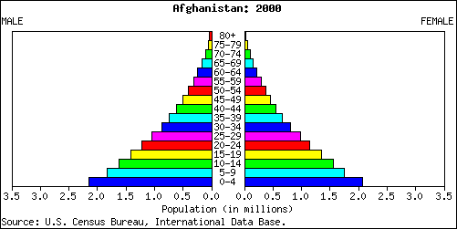
Population pyramids are used to show information about the age and gender of people in a specific country.
Male
Female
There is also a high death rate.
In this country there is a high birthrate
Population in millions
This population pyramid is typical of countries in poorer parts of the world (LEDCs.)

Slide 3
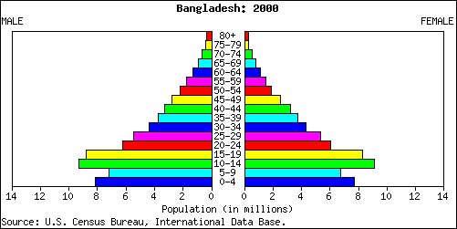
In some LEDCs the government is encouraging couples to have smaller families. This means the birth rate has fallen.

Slide 4
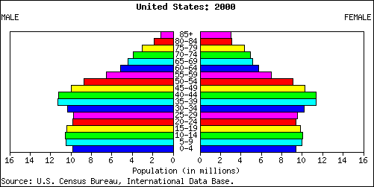
Male
Female
The largest category of people were born about 40 years ago.
In this country the number of people in each age group is about the same.
Population in millions
In this country there is a low birthrate and a low death rate.
This population pyramid is typical of countries in the richer parts of the world (MEDCs.)

Slide 5
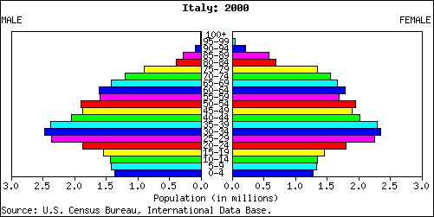
Male
Female
Population in millions
In this country the birth rate is decreasing.
In the future the elderly people will make up the largest section of the population in this country.
This is happening more and more in many of the world’s richer countries.

Slide 6
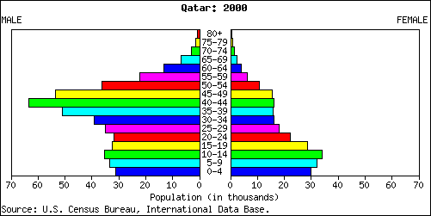
Male
Female
Population in thousands
This country has a large number of temporary workers. These are people who migrate here especially to find a job.

Slide 7
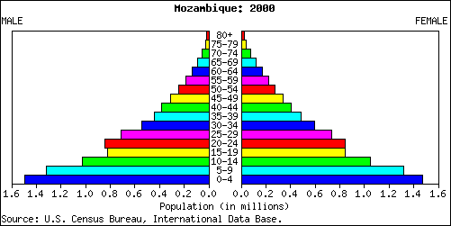
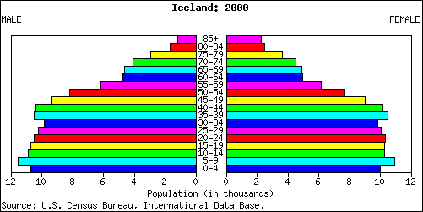
Population pyramid for Mozambique
Population pyramid for Iceland

Slide 8
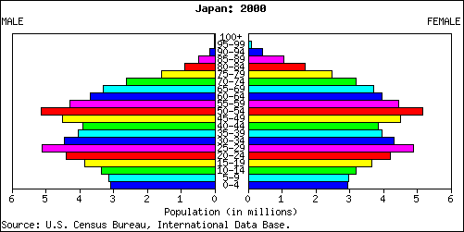
What happens next?

Slide 9
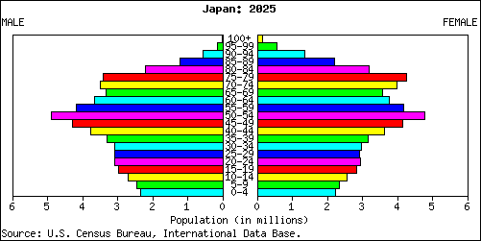

Slide 10
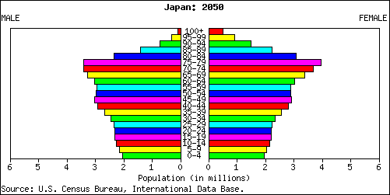
What is going to happen to Japan’s population in the future?
Why does this matter?

Slide 11
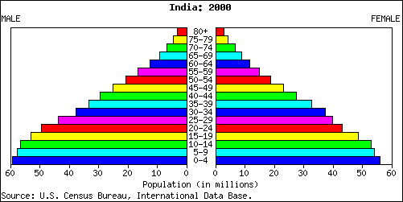
?

Slide 12
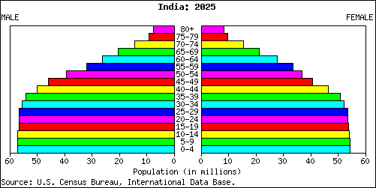
?

Slide 13
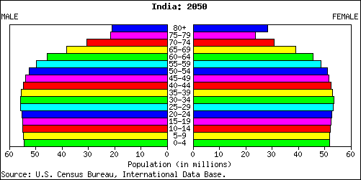
?

Slide 14
Your task:
Open your own PowerPoint presentation.
Look at the list of LDCs (less developed countries) on Wikipedia and choose 1 from the list; look at the list of developed countries and choose 1 MDC (more developed country) from the first list given
Go to www.census.gov
Select Search and type in IDB.
Select International Database
Select Data Access
Find a population pyramid for the LDC you chose for 2010; save the picture and insert it into a Word document; write at least 3 sentences that explain/describe the data shown in the pyramid
Repeat for the MDC you chose
Choose any other country and find population pyramids for 2000, 2025 and 2050
Write two paragraphs explaining/describing what the graphs show and give reasons for the patterns. Explain how the population of this country is changing and hypothesize about how this could affect the country.

Slide 15
When you have finished:
Find out some background information on each country and add this to your document. Concentrate on facts and figures that can be used to compare the countries such as % of children in school, type of jobs available, the GDP per capita, etc.

